Slide 1

CSD 3102- ARTIFICIAL INTELLIGENCE TECHNIQUES
MODULE 4 PLANNING GRAPHS Topic-Conditional Planning-Reactive Planning - Knowledge based Planning-Using Temporal Logic – Execution Monitoring and Re-planning- Continuous Planning-Multi-agent Planning-Job shop Scheduling Problem

Slide 2
CONDITIONAL PLANNING

Slide 3
Conditional Planning
UNCERTAINTY
The agent might not know what the initial state is.
The agent might not know the outcome of its actions.
The plans will have branches rather than being straight line plans, includes conditional steps
if < test > then plan_{A} else plan_{B}
Full observability: The agent knows what state it currently is, does not have to execute an observation action
Simply get plans ready for all possible contingencies

Slide 4


The vacuum world example
Double Murphy world
the vacuum cleaner sometimes deposits dirt when it moves to a clean destination square sometimes deposits dirt if SUCK is applied to a
clean square
The agent is playing a game against nature

Slide 5





















Perform and-or search
Left
Suck
GOAL
Suck
LOOP
Right
Suck
Left
GOAL
LOOP

Slide 6
The conditional plan
In the “double-Murphy” vacuum world, the plan is: [
Left,
if AtL ∧ CleanL ∧ CleanR
then [ ]
else Suck
]

Slide 7
REACTIVE PLANNING

Slide 8
Reactive Planning
Reactive planning is suitable for highly dynamic and unpredictable environments.
Rather than following a pre-defined plan, the AI agent continuously reacts to changes in the environment in real-time.
This approach doesn’t rely on creating a full plan ahead of time but focuses on immediate responses to the current situation.
Example: A robot avoiding obstacles in an unknown environment or video game AI adapting to player actions.

Slide 9
Key Features:
Real-time Adaptation: AI reacts dynamically to changes in the environment.
No Pre-computed Plan: Focuses on immediate actions rather than long-term planning.
Challenges: May lack long-term strategy or foresight, focusing only on immediate responses.

Slide 10
Example: A robot avoiding obstacles in an unknown environment – Apply Reactive Planning
Key components in STRIPS:
Initial State: Describes the robot's starting environment.
Goal State: The robot's objective (e.g., reaching a destination without hitting obstacles).
Actions: The possible actions the robot can take (e.g., move forward, turn left, turn right).
Preconditions: Conditions that must be true for an action to occur.
Effects: How actions change the state of the world.

Slide 11
Example in STRIPS terms:
Initial State:
Robot at (x1, y1)
No obstacle ahead
Goal State:
Robot reaches (x_goal, y_goal)
Actions:
MoveForward:
Preconditions: No obstacle ahead
Effects: Robot moves to a new position (x2, y2)
TurnLeft:
Preconditions: Obstacle ahead
Effects: Robot changes direction to the left
TurnRight:
Preconditions: Obstacle ahead
Effects: Robot changes direction to the right

Slide 12
Process:
Initial State: Robot starts at a location, scanning for obstacles.
If there is no obstacle, it performs the MoveForward action.
If an obstacle is detected, the robot reacts by either TurnLeft or TurnRight.
This loop continues until the robot reaches the goal state.
In reactive planning, the robot doesn’t plan beyond this simple loop. It constantly senses, checks the preconditions (like obstacle presence), and reacts with the appropriate action.

Slide 13
Knowledge based Planning-Knowledge based Planning using Temporal Logic

Slide 14
Knowledge based Planning
Knowledge-based planning in AI refers to the process of using structured knowledge, often in the form of rules, facts, and logical relationships, to guide decision-making and achieve specific goals.
This approach leverages pre-existing knowledge(past plan) about the world or a particular domain to generate plans that solve problems or accomplish tasks.

Slide 15
Knowledge based Planning using Temporal Logic
Temporal logic is a branch of logic that extends classical logic by introducing time-based elements.
It allows for reasoning about how things change over time, which is particularly useful when dealing with systems or processes that evolve, such as in scheduling, robotics, or automated systems.

Slide 16
Key Concepts in Temporal Logic:
Time and Events: Temporal logic allows you to express statements not just about static truths but about how these truths change over time. You can describe when certain conditions hold true relative to time.
Temporal Operators: These are special symbols or keywords that capture the temporal relationships between events:
"Before": Something happens before another event.
"After": One event happens after another.
"During": An event or condition holds true during a certain period.
"Until": A condition remains true until another condition becomes true.

Slide 17
Applications Knowledge based Planning using Temporal Logic
Modeling Dynamic Systems: Temporal logic is valuable in representing systems that change state over time, such as automated systems, traffic control, or process management. AI systems can plan and execute actions while reasoning about when certain actions should occur.
Formal Verification: In AI, temporal logic is often used in the formal verification of systems. This involves ensuring that a system behaves correctly over time, according to its specifications. For example, in robotics, you can ensure a robot follows safety protocols "until" certain conditions are met.

Slide 18
3.Natural Language Processing (NLP): Temporal logic can be used to help AI systems understand and reason about time-based phrases in natural language, such as "I will go to the store after I finish my work.“
4.Automated Planning and Scheduling: In temporal planning systems, AI uses temporal logic to reason about sequences of actions and when they should occur. The system determines the most efficient order and timing to achieve a goal.

Slide 19
Temporal Logic with Strips
When combining Temporal Logic with STRIPS, you extend the traditional STRIPS framework to include reasoning about the timing of actions.
Traditional STRIPS Components:
initial State,
Action: Precondition, effect
Goal State.
Adding Temporal Logic to STRIPS
Temporal logic enables the planner to reason about when actions should take place. This extension allows us to model not only which actions should be taken but also their timing and duration.

Slide 20
Example Scenario: Delivering a Package with Temporal Logic in STRIPS
Let’s consider an autonomous delivery robot that needs to pick up a package from Location A and deliver it to Location B. We want to include temporal constraints such as:
-The package can only be picked up after it arrives at Location A.
-The package must be delivered before a certain time.
-The robot must be at Location A during the package’s arrival window.

Slide 21
Initial State:
At(robot, Location C)
At(package, Location A)
Time: 10:00 AM
Goal State: Delivered(package)
Plan with Temporal Reasoning:
Move(robot, Location C, Location A): The robot moves from Location C to Location A.
Preconditions:At(robot, Location C)
Effects:¬At(robot, Location C) , At(robot, Location A)
Temporal Constraint: This action must complete before the package arrives (e.g., before 11:00 AM if the package arrives at 11:00 AM).

Slide 22
2. PickUp(robot, package, Location A): The robot picks up the package after it arrives at Location A.
Preconditions: At(robot, Location A) , At(package, Location A)
Effects:¬At(package, Location A) , Has(robot, package)
Temporal Logic: This action is valid after the package is at Location A.
3. Move(robot, Location A, Location B):The robot moves to Location B to deliver the package.
Preconditions: At(robot, Location A)
Effects:¬At(robot, Location A) , At(robot, Location B)

Slide 23
4. Deliver(robot, package, Location B):The robot delivers the package at Location B.
Preconditions:At(robot, Location B) , Has(robot, package)
Effects:¬Has(robot, package), Delivered(package)
Temporal Logic: This must occur before the time limit (e.g., 12:00 PM).
Temporal STRIPS in Action:
By adding temporal logic to the STRIPS planning framework, the AI system can plan not only what actions to take but also when those actions must occur to respect time-based constraints, such as deadlines or event windows. In this example, the robot’s plan involves not just picking up and delivering the package but doing so in a timely manner, ensuring it meets all the temporal requirements.

Slide 24
Execution Monitoring and Re-planning

Slide 25
Execution Monitoring and Re-planning
An execution monitoring agent checks its percepts to see whether everything is going according to plan.
Two kinds of execution monitoring:
Action monitoring, whereby the agent checks the environment to verify that the next action will work.
Plan monitoring, in which the agent verifies the entire remaining plan.
A replanning agent knows what to do when something unexpected happens: call a planner again to come up with a new plan to reach the goal.

Slide 26
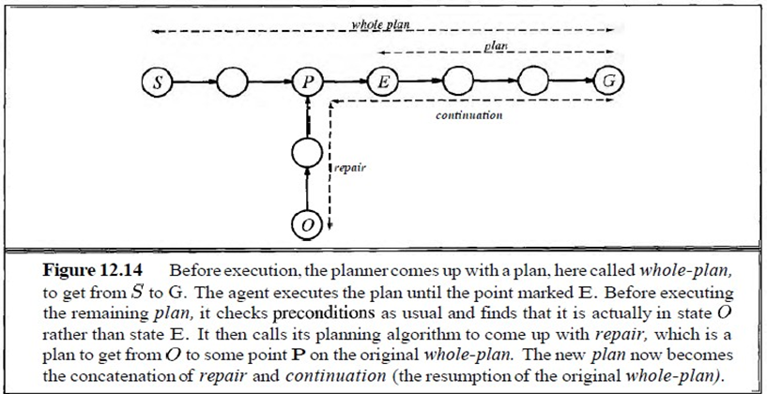

Slide 28
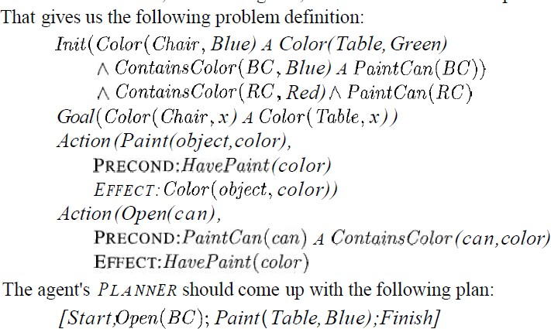
Example problem of achieving a chair and table of matching color, this time via replanning. We'll assume a fully observable environment. In the initial state the chair is blue, the table is green, and there is a can of blue paint and a can of red paint. That gives us the following problem definition:

Slide 29
Now the agent is ready to execute the plan.
Assume that all goes well as the agent opens the blue paint and applies it to the table.
The agents from previous sections would declare victory at this point, having completed the steps in the plan.
But the execution monitoring agent must first check the precondition of the Finish step, which says that the two pieces must have the same color.
Suppose the agent perceives that they do not have the same color, because it missed a spot of green on the table.
The agent then needs to figure out a position in whole-plan to aim for and a repair action sequence to get there.

Slide 30
Continuous Planning

Slide 31
Continuous Planning
In this planning, the planner at first achieves the goal and then only can stop.
A continuous planner is designed to persist over a lifetime.
It can handle any unfavorable circumstances in the environment.

Slide 32
Fixing plan flaws continually
Missing goal: adding new goals
Open precondition: close using causal links (POP)
Causal conflict: resolve threats (POP)
Unsupported link: remove causal links supporting conditions that are no longer true
Redundant action: remove actions that supply no causal links
Unexecuted action: return an action that can be executed
Unnecessary historical goal: if the current goal set has been achieved, remove them and allow for new goals

Slide 33
Continuous planning algorithm
function CONTINUOUS-POP-AGENT(percept) returns an action
action NoOp (the default)
EFFECTS[Start] = UPDATE(EFFECTS [Start], percept) REMOVE-FLAW(plan) // possibly updating action return action

Slide 34
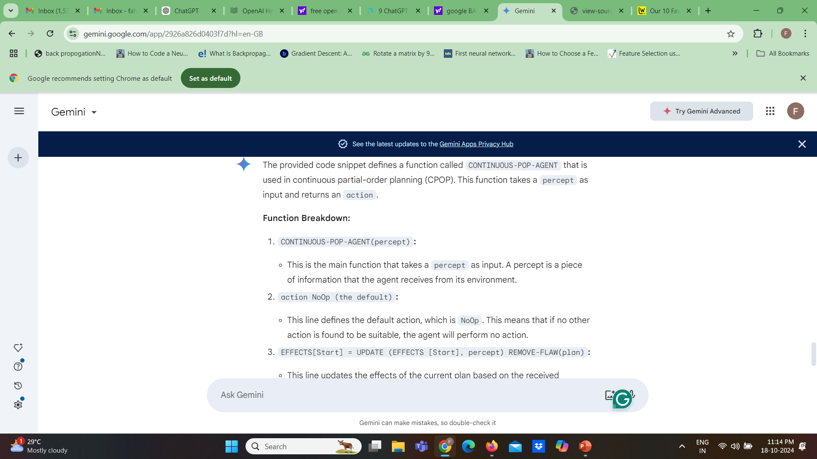

Slide 35
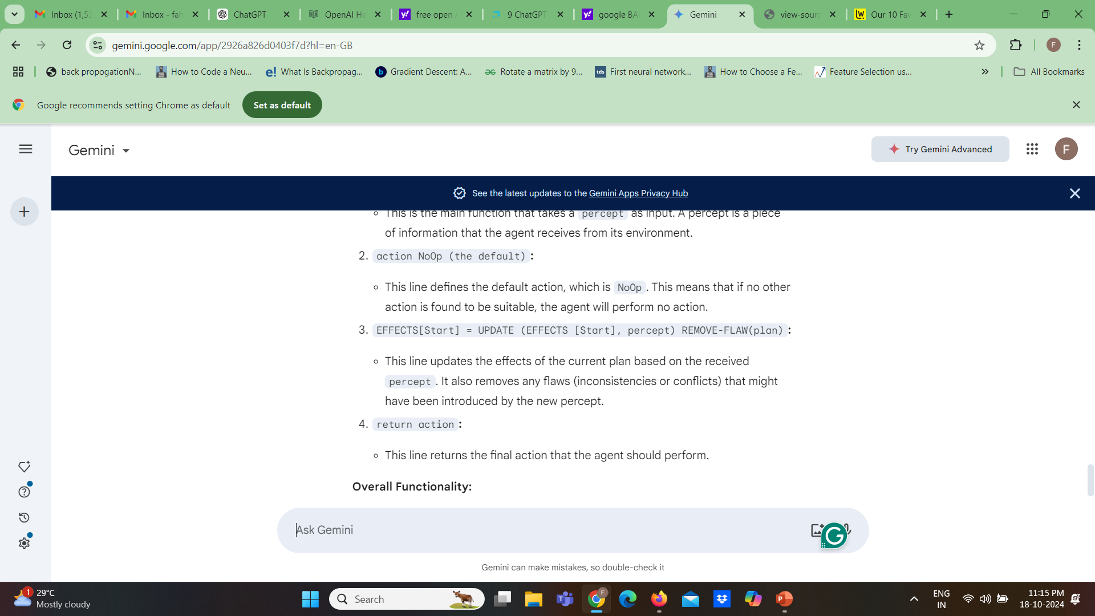

Slide 36
The Continuous_POP_agent function essentially takes a percept, updates the plan based on the new information, and returns the appropriate action to be executed.
This process is repeated continuously as the agent interacts with its environment and receives new percepts.

Slide 37
Example - start
 |  |  | C
 |  |  | D
 |  |  | B
 | A |  | E |  | F |  | G
D
 |  |  | D
 | C |  | B
 | A |  | E |  | F |  | G
 |  |  | B |  | C |  | D
 | A |  | E |  | F |  | G
B
C
A
E
F
G
Start
Someone moved D
dropped C
tried again
Ontable(A) On(B,E)
On(C,F)
On(D,G)
Clear(A) Clear(C) Clear(D) Clear(B)
On(C,F)
Clear(C) Clear(D)
Move(C,D)
Start
On(C,D)
On(D,B)
Finish
On(D,G)
Clear(D) Clear(B)
Move(D,B)

Slide 38
Example - after D is moved onto B
 |  |  | C
 |  |  | D
 |  |  | B
 | A |  | E |  | F |  | G
D
 |  |  | D
 | C |  | B
 | A |  | E |  | F |  | G
 |  |  | B |  | C |  | D
 | A |  | E |  | F |  | G
B
C
A
E
F
G
Start
Someone moved D
dropped C
tried again
Ontable(A) On(B,E)
On(C,F)
On(D,B)
Clear(A) Clear(C) Clear(D) Clear(G)
On(C,F)
Clear(C) Clear(D)
Move(C,D)
Start
On(C,D)
On(D,B)
Finish
On(D,y)
Clear(D) Clear(B)
Move(D,B)

Slide 39
Example - Move(D,B) was redundant
 |  |  | C
 |  |  | D
 |  |  | B
 | A |  | E |  | F |  | G
D
 |  |  | D
 | C |  | B
 | A |  | E |  | F |  | G
 |  |  | B |  | C |  | D
 | A |  | E |  | F |  | G
B
C
A
E
F
G
Start
Someone moved D
dropped C
tried again
Ontable(A) On(B,E)
On(C,F)
On(D,B)
Clear(A) Clear(C) Clear(D) Clear(G)
On(C,F)
Clear(C) Clear(D)
Move(C,D)
Start
On(C,D)
On(D,B)
Finish

Slide 40
Example - Move(C,D) was executed
 |  |  | C
 |  |  | D
 |  |  | B
 | A |  | E |  | F |  | G
D
 |  |  | D
 | C |  | B
 | A |  | E |  | F |  | G
 |  |  | B |  | C |  | D
 | A |  | E |  | F |  | G
B
C
A
E
F
G
Start
Someone moved D
dropped C
tried again
Ontable(A) On(B,E)
On(C,A)
On(D,B)
Clear(F) Clear(C) Clear(D) Clear(G)
Start
On(C,D)
On(D,B)
Finish

Slide 41
Example - put Move(C,D) back in
 |  |  | C
 |  |  | D
 |  |  | B
 | A |  | E |  | F |  | G
D
 |  |  | D
 | C |  | B
 | A |  | E |  | F |  | G
 |  |  | B |  | C |  | D
 | A |  | E |  | F |  | G
B
C
A
E
F
G
Start
Someone moved D
dropped C
tried again
Ontable(A) On(B,E)
On(C,A)
On(D,B)
Clear(F) Clear(C) Clear(D) Clear(G)
On(C,A)
Clear(C) Clear(D)
Move(C,D)
Start
On(C,D)
On(D,B)
Finish

Slide 42
Example - plan complete
 |  |  | C
 |  |  | D
 |  |  | B
 | A |  | E |  | F |  | G
D
 |  |  | D
 | C |  | B
 | A |  | E |  | F |  | G
 |  |  | B |  | C |  | D
 | A |  | E |  | F |  | G
B
C
A
E
F
G
Start
Someone moved D
dropped C
tried again
Ontable(A) On(B,E)
On(C,D)
On(D,B)
Clear(F) Clear(C) Clear(D) Clear(G)
Start
On(C,D)
On(D,B)
Finish

Slide 43
Multiagent planning (MAP)

Slide 44
Multiagent planning
Cooperation: Joint goals and plans
Multibody planning: Synchronization, joint actions, concurrent actions
Coordination mechanisms: convention, social laws, emergent behavior, communication, plan recognition, joint intention
Competition: agents with conflicting utility functions
This may lead to a poor performance because dealing with other agents is not the same as dealing with the nature. It is necessary when there are other agents in the environment with which to cooperate, compete or coordinate.

Slide 45
Multi-Agent Planning (MAP) in AI refers to the process where multiple autonomous agents collaborate (or sometimes compete) to achieve their goals in a shared environment. Each agent may have its own objectives, but their actions can affect others, so coordination or conflict resolution becomes critical.
Concepts in Multi-Agent Planning:
1. Multiple Agents: Unlike single-agent planning, where one agent is responsible for achieving a goal, multi-agent planning involves several agents, each with its own knowledge, capabilities, and goals.

Slide 46
2. Communication: Agents may need to exchange information to coordinate their actions. Some multi-agent systems assume full communication, while others assume no communication, meaning the agents must plan without direct coordination.
3. Decentralized vs. Centralized Planning:
Centralized Planning: A single entity plans for all agents. This can ensure optimal solutions but may become computationally infeasible for large systems.
Decentralized Planning: Each agent plans independently, but they must take into account the actions of other agents. This is more scalable but can lead to suboptimal outcomes if agents don’t coordinate well.

Slide 47
Types of Multi-Agent Planning:
1.Fully Cooperative Planning: All agents share a common goal, and the focus is on optimizing their joint actions to achieve the best outcome. Example: A fleet of delivery drones working together to minimize delivery time.
2.Competitive or Adversarial Planning: Agents have conflicting goals. Each agent must predict the actions of others and plan accordingly. Ex: In a game like chess, two players (agents) compete to win
3.Mixed Planning (Cooperative and Competitive): Some agents collaborate, while others compete. This is common in real-world situations, such as market systems or resource management, where some entities cooperate while others compete for limited resources. ample: In a game like chess, two players (agents) compete to win.

Slide 48
Example: Autonomous Vehicles
In a scenario where multiple autonomous vehicles (agents) share the road, they need to plan their routes and adjust their actions based on the movements of others. Each vehicle has its own goal (reaching a destination), but they must avoid collisions, follow traffic rules, and possibly cooperate at intersections.
Cooperation: Vehicles may cooperate to form platoons, optimizing fuel consumption and speed.
Competition: At busy intersections, vehicles must resolve potential conflicts over who goes first, often using communication or prediction of other vehicles' behavior.

Slide 49
Step 1: Vehicle1 starts at locationA detects a clear intersection, and decides to move to the intersection:
Move(vehicle1, locationA, intersection)
Preconditions are satisfied (At(vehicle1, locationA) and Clear(intersection))
Effects: Vehicle1 reaches the intersection, and the intersection becomes occupied (not(Clear(intersection)))

Slide 50
Step 2: Vehicle2, at location must wait until the intersection is clear:
The precondition Clear(intersection) is false for vehicle2, so it cannot proceed.
Vehicle2 must wait until vehicle1 moves through the intersection.
Step 3: Vehicle1 moves from the intersection to its destination:
Move(vehicle1, intersection, destination1)
Preconditions are satisfied (At(vehicle1, intersection) and Clear(destination1))
Effects: Vehicle1 reaches its destination, and the intersection becomes clear (Clear(intersection))

Slide 51
Step 4: Vehicle2 can now move into the intersection:
Move(vehicle2, locationB, intersection)
Preconditions are satisfied ( At(vehicle2, locationB) and Clear(intersection) )
Effects: Vehicle2 reaches the intersection, and the intersection becomes occupied again (not(Clear(intersection)))
Step 5: Vehicle2 moves to its destination after the intersection is clear again.
Coordination in STRIPS:
Coordination is implicitly handled by the preconditions on shared resources (Clear(intersection) ). Each vehicle must check the status of the intersection before proceeding.

Slide 52
JOB SHOP SCHEDULING PROBLEM-

Slide 53
JOB SHOP SCHEDULING PROBLEM- (Flipped Classroom)
Job Shop Scheduling Problem (JSSP), which aims to schedule several jobs over some machines in which each job has a unique machine route, for finding optimal sequences over machines.
Assume there are 3 jobs (J1, J2, J3) and 4 Machines (M1, M2, M3, M4)
Generate a plan estimating the duration of the job or processes and how it can handle the resources or machines.

Slide 54
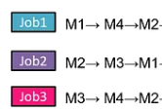
Generate a plan estimating the duration of the job or processes and how it can handle the resources or machines. Assume the Machine sequence of job execution given below while planning the activity.

Slide 55
Assumptions:
Each job has 3 operations.
Each operation has a set duration on a specific machine.
Machines can only process one job at a time.
Operations within a job must be completed in a predefined sequence (no parallelism within the same job).
All jobs are available to start at time 0.

Slide 56
Operations and Durations:
Job 1 (J1):
J1, Operation 1: Process on Machine 1 (M1) for 5 units of time.
J1, Operation 2: Process on Machine 3 (M3) for 8 units of time.
J1, Operation 3: Process on Machine 4 (M4) for 6 units of time.
Job 2 (J2):
J2, Operation 1: Process on Machine 2 (M2) for 4 units of time.
J2, Operation 2: Process on Machine 3 (M3) for 7 units of time.
J2, Operation 3: Process on Machine 1 (M1) for 3 units of time.

Slide 57
Job 3 (J3):
J3, Operation 1: Process on Machine 1 (M1) for 6 units of time.
J3, Operation 2: Process on Machine 4 (M4) for 5 units of time.
J3, Operation 3: Process on Machine 2 (M2) for 7 units of time.

Slide 58
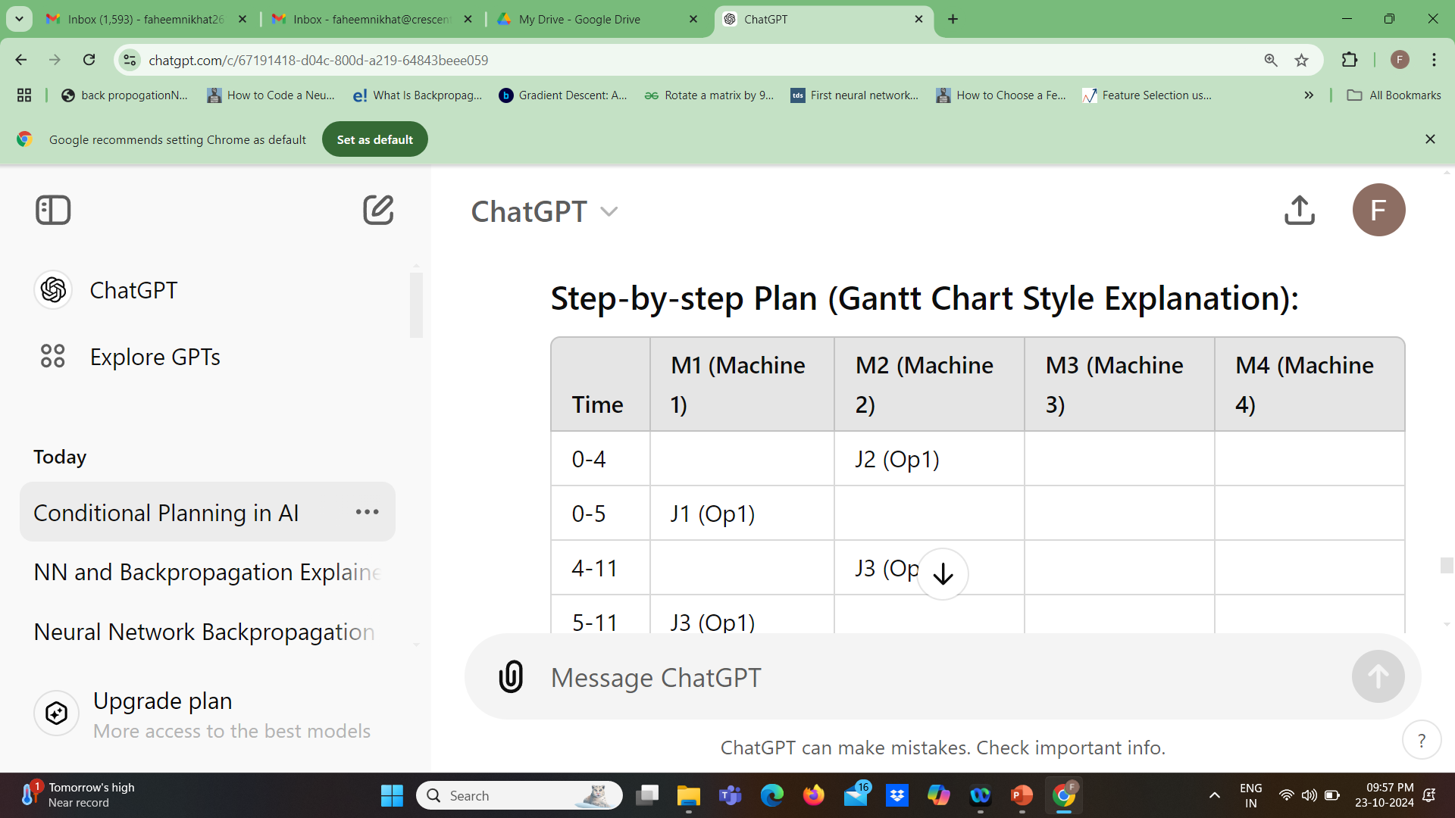

Slide 59
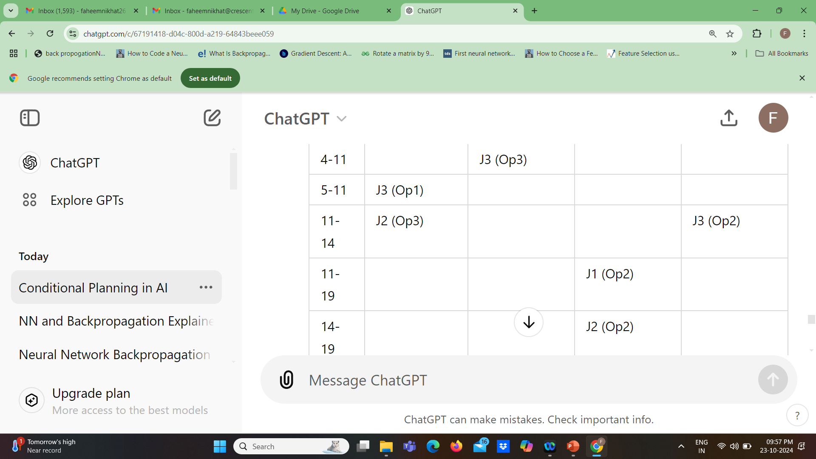

Slide 60
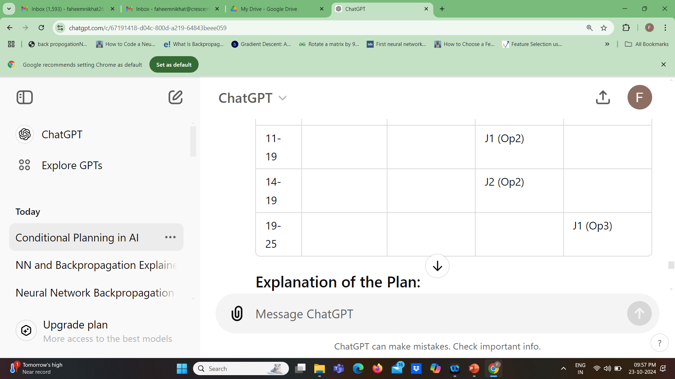

Slide 61
Explanation of the Plan:
Time 0-5: Job 1 starts on Machine 1 for its first operation (Op1), and Job 2 starts on Machine 2 for its first operation (Op1). No conflicts, so these run in parallel.
2.Time 4-11: After Job 2 completes its first operation on Machine 2 (Op1), Job 3 takes over Machine 2 for its third operation (Op3) for 7 units of time. Job 3 also starts on Machine 1 for its first operation (Op1) when Machine 1 becomes free at time 5, right after Job 1 finishes.

Slide 62
3.Time 11-19: Once Machine 1 becomes available again at time 11, Job 2 completes its final operation (Op3) there. Meanwhile, Job 1 moves to Machine 3 for its second operation (Op2), and Job 2 moves to Machine 3
4.Time 19-25: Job 1 finishes its final operation on Machine 4, completing at time 25. All jobs complete successfully without any machine conflicts. after Job 1 is done.
Makespan:
The total time taken (makespan) is 25 units. This is the point when the last job finishes its last operation.

Slide 63
Handling Resources (Machines):
Machine 1 (M1):
Handles J1 (Op1), J3 (Op1), and J2 (Op3).
Utilization: Used at time intervals 0-5, 5-11, and 11-14.
Machine 2 (M2):
Handles J2 (Op1) and J3 (Op3).
Utilization: Used at time intervals 0-4 and 4-11.
Machine 3 (M3):
Handles J1 (Op2) and J2 (Op2).
Utilization: Used at time intervals 11-19 for J1 and J2.
Machine 4 (M4):
Handles J3 (Op2) and J1 (Op3).
Utilization: Used at time intervals 11-14 and 19-25.

